Slide 1
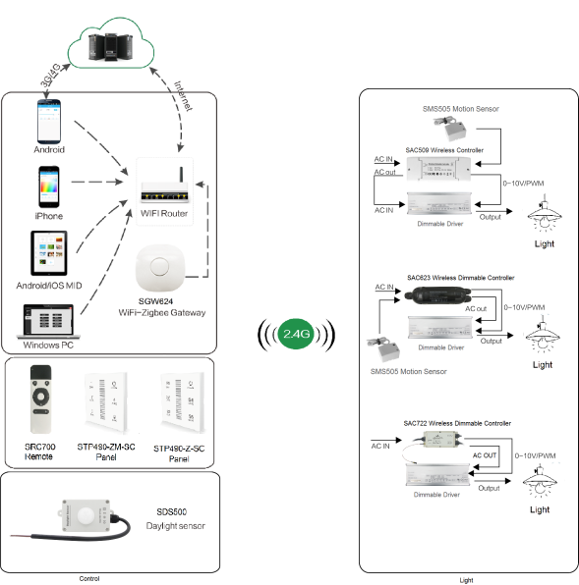
System Diagram
Add.: B906, Nanfang Building, Luofang Rd. Luohu Distr., Shenzhen, China,518000. Tel: +86 755 82683776 Email: info@star-an.com

Slide 2
Features
Based on HA1.2 standard protocol
Built-in ZigBee 2.4G wireless transceiver module
Supports large number of 2,500 devices connection.
Internal wire and external wire are optional.
Able to achieve short & long distance controlling LED lights by
multi solutions
Work with 1-10V or 0-10V dimming drivers, daylight sensor
and motion sensor
Internal and External wire optional
Power metering
IP20
Support Over-the-Air upgrade
Add.: B906, Nanfang Building, Luofang Rd. Luohu Distr., Shenzhen, China,518000. Tel: +86 755 82683776 Email: info@star-an.com

Slide 3
Parameter
Patameter | SAC509-Z-SC-3-PM-1C-IA/EA-R-OTA
Input Power/ Voltage | AC 100-277Vac 50/60Hz 1-10V
0-10V Max Current | 15mA Max
Relay Max Current | 5A Max
Frequency | 2.4GHz
Control Distance | 20-30m
Motion Sensor | Yes
Daylight Sensor | Yes
Operation Temperature | -40°C to 85°C
Dimension | 140mmx50mmx30mm
Note：a.The terminal of the product bears the maximum torque torque≦0.3N. m b.Shell lock screw bearing maximum torque torque≦0.2N.m
Add.: B906, Nanfang Building, Luofang Rd. Luohu Distr., Shenzhen, China,518000. Tel: +86 755 82683776 Email: info@star-an.com

Slide 4
Installation
For installation details, please contact us for spec. for your ref.
Add.: B906, Nanfang Building, Luofang Rd. Luohu Distr., Shenzhen, China,518000. Tel: +86 755 82683776 Email: info@star-an.com

